Slide 1
ERM - Entity Relationship Modeling
ERD depicts the conceptual model of a database
Entities - Entity is a set of objects, not a single instance or occurrence
Attributes - Characteristics of an entity
Relationships - Association between entities

Slide 2
Attributes
Domain – Set of possible values for a given attribute
Types (not to be confused with data types)
Required Must have a value, cannot be null
Optional Does not require a value, can be null
Simple Cannot be subdivided
Composite Can be subdivided to yield additional attributes
Single-valued Has only a single value (not to be confused with domain)
Multivalued Can have many values (not to be confused with domain)
Derived Value is calculated from other attributes

Slide 3
Attributes Types (Example)
STUDENT entity (some possibilities)
CWID required simple single-valued
FIRST NAME required simple single-valued
LAST NAME required simple single-valued
MIDDLE INIT optional simple single-valued
ADDRESS ES required composite multivalued
PHONES optional simple multivalued
GPA required simple single-valued
DOB required simple single-valued
AGE required simple single-valued derived

Slide 4
Attributes Types (Example)
ADDRESSES as single valued and simple
PERMANENT
PERM_LINE1 required simple single-valued
PERM_LINE2 optional simple single-valued
PERM_STATE required simple single-valued
PERM_ZIP required simple single-valued
LOCAL
LOCAL_LINE1 optional simple single-valued
LOCAL_LINE2 optional simple single-valued
LOCAL_STATE optional simple single-valued
LOCAL_ZIP optional simple single-valued

Slide 5
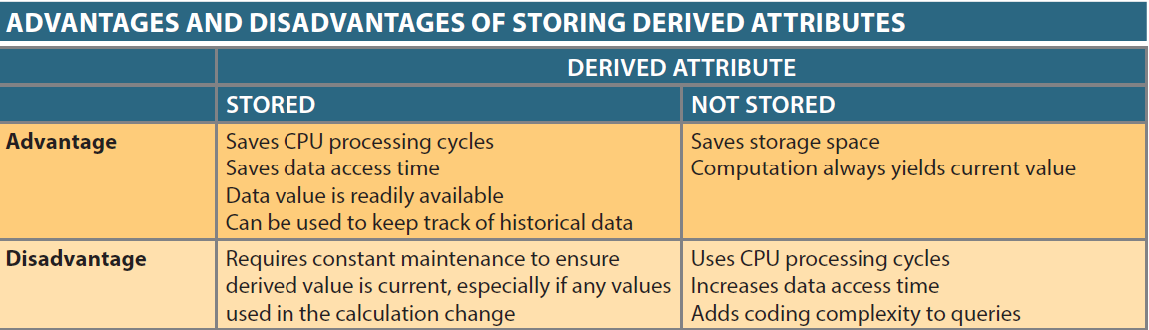
Attributes Types
AGE as a derived attribute, calculated from the DOB

Slide 6
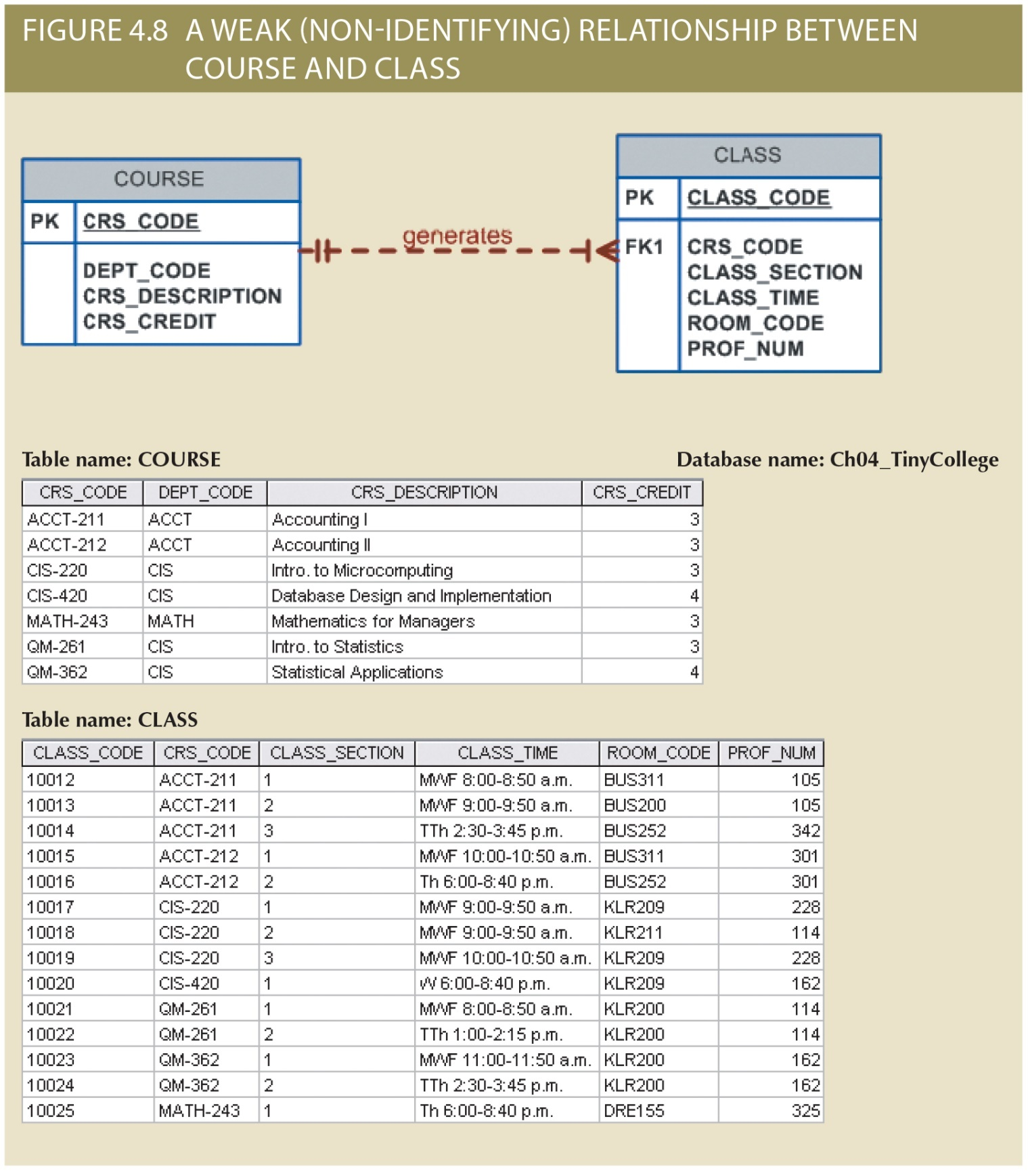
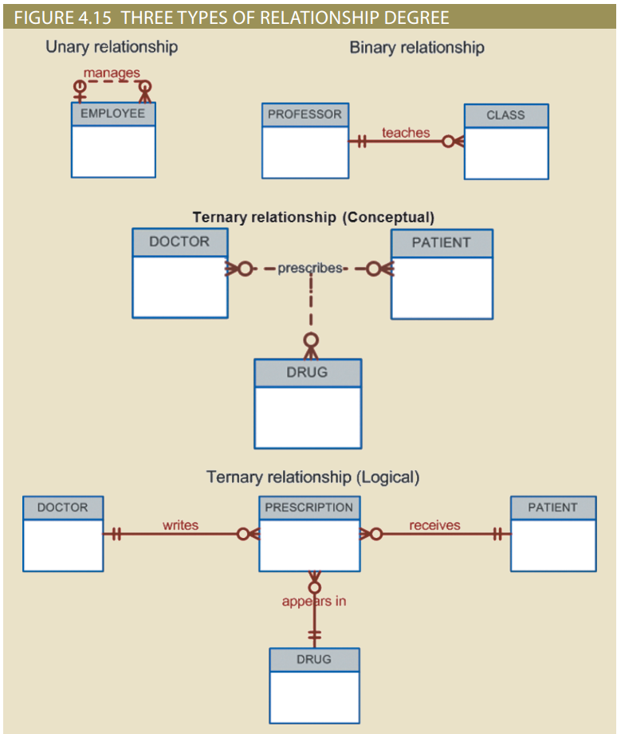
Entities
Participants – Entities participating in a relationship

Slide 7
Entities
Entity strength – Determined by property of existence dependence
Existence-dependent (weak) – exists only when it is associated with another related entity occurrence
It cannot exist without the related entity
PK is partially or totally derived from its related entity
It has a required foreign key
Example: employees having dependents
Existence-independent (strong) – exists apart from its related entities
It can exist without any related entities
PK is not derived from its related entity
It does not have any required foreign keys
Example: company produce some parts while also getting some parts from a vendor

Slide 8
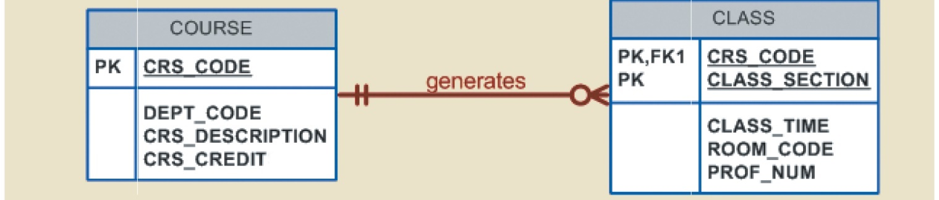
Entity Strength
Strong Weak
Strong Weak
Do not confuse this with relationship strength!

Slide 9


Relationships
Relationship strength – based on the PK of a related entity
Non-identifying (weak) – PK of the related entity does not contain a PK component of the related entity
Identifying (strong) – PK of the related entity contains a PK component of the related entity
Do not confuse this with entity strength!

Slide 10
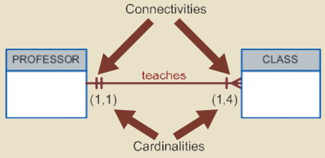
Relationships
Connectivity – describes the relationship classification
See Chapter 3 – (1:1), (1:M), (M:N)
Cardinality – expresses the min and max number of entity occurrences associated with one occurrence of the related entity

Slide 11
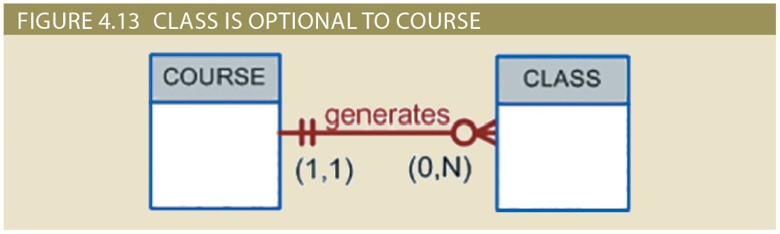
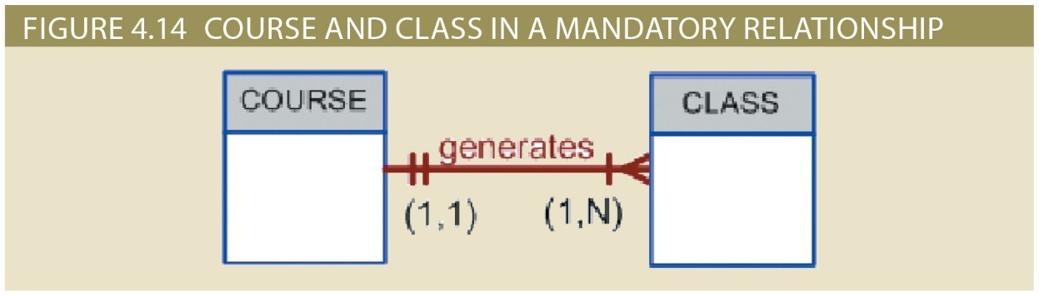
Relationships
Participation
Optional – One entity occurrence does not require a corresponding entity occurrence in the related entity
Mandatory - One entity occurrence requires a corresponding entity occurrence in the related entity

Slide 12
Relationships
Degree – number of participants associated with a relationship
Unary (or recursive) – relationship maintained within a single entity
Relationship exists between occurrences of the same entity
Binary – relationship maintained between two entities
Ternary – relationship maintained among three entities
Higher order – relationship maintained among more than three entities

Slide 13
Relationships

Slide 14
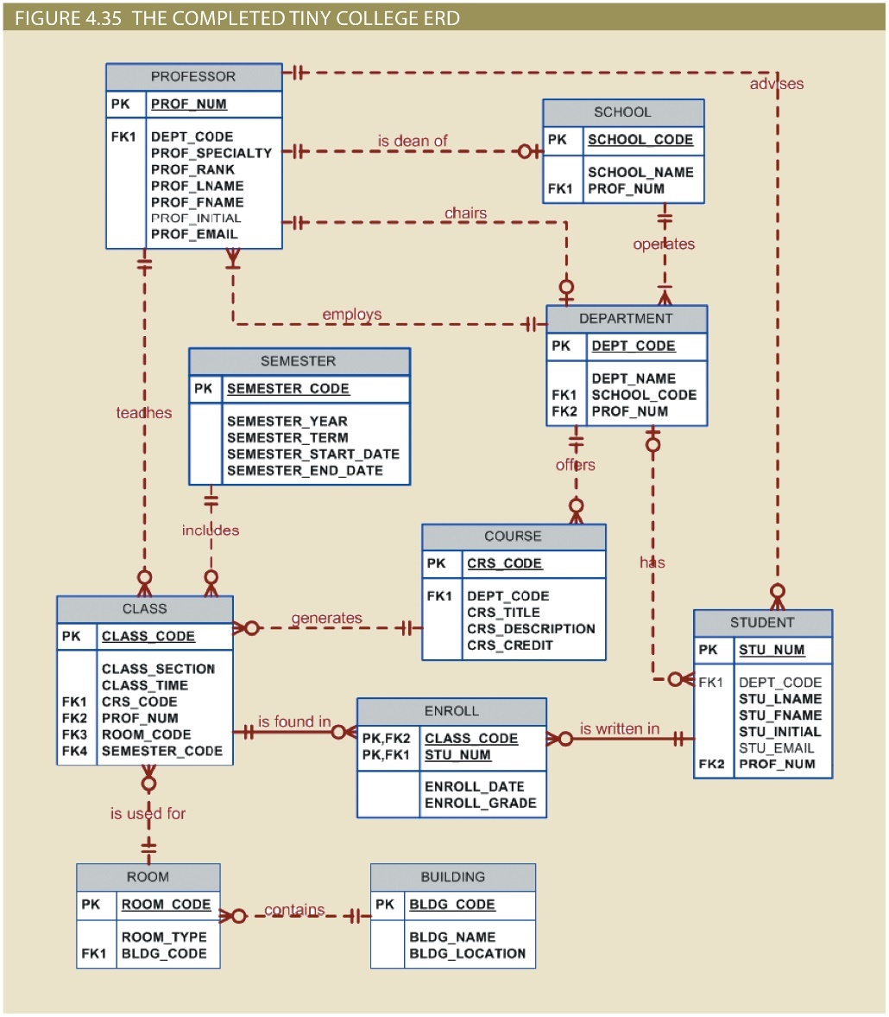
Our ERD Requirements - Entities
Name at the top
Attributes
PK – PK label, bold, underlined
FK
FK label with #, if more than one
Required – bold
Optional – not bold
PK component underlined
Other attributes
Required – bold
Optional – not bold

Slide 15
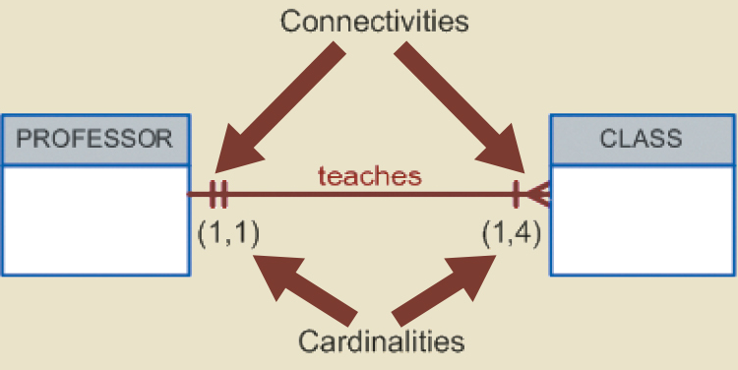
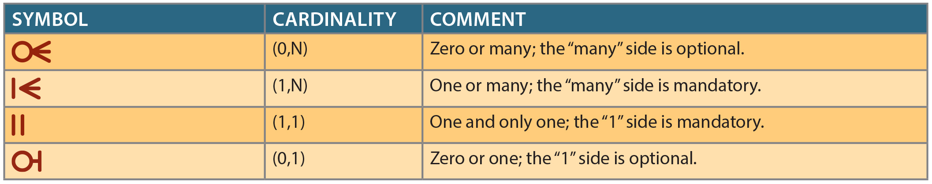
Our ERD Requirements - Relationships
Labels – verb (typically), concise, intuitive
Connectivity - O:1, 1:1, O:M, 1:M
Must use the correct symbol on both sides
Participation – Optional or mandatory
Must use the correct symbol on both sides

Slide 16
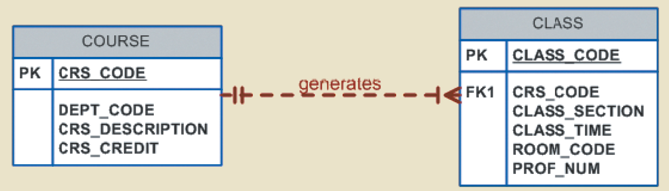
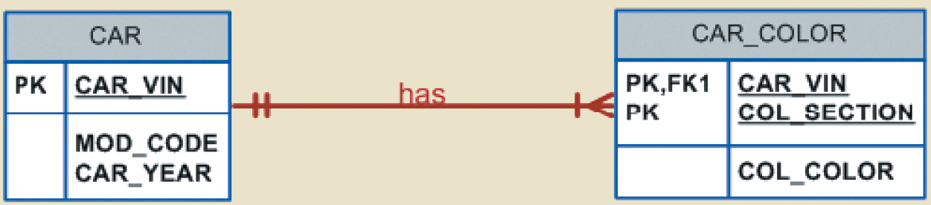
Our ERD Requirements - Relationships
Cardinality – number of related occurrences
You must have the cardinality, except for those that are covered by the connectivity symbols
Strength
Weak - dashed line
Strong - solid line

Slide 17
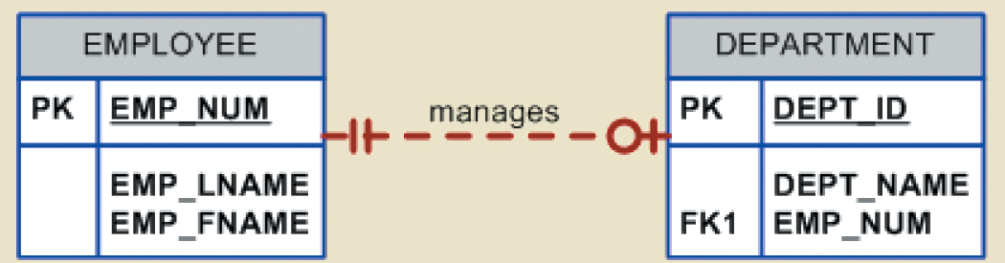
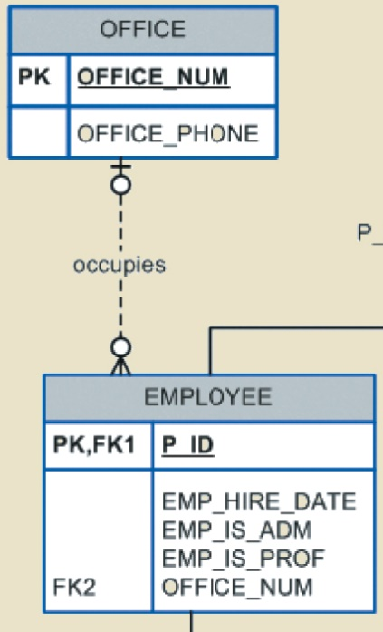
Our ERD Requirements - Relationships

Slide 18
Our Relational Schema Notation
Name – typically uppercase
Parenthesis – holds the attribute list
Attributes – comma-separated list, typically lowercase
PK – bold, underlined
FK – italicized and:
Required – bold
Optional – not bold
Other attributes
Required – bold
Optional – not bold

Slide 19
Our Relational Schema Notation
EMPLOYEE(emp_num, emp_name, emp_dept)
DEPARTMENT(dept_num, dept_name, mgr_emp_num)
CLASS(crs_code, class_section, time, prof_emp_num)
COURSE(crs_code, dept_num, crs_descr, crs_credit)
Note that these examples do not necessarily correspond to an ERD from the book or other class material.

Slide 20
Our Relational Schema Notation
Remember: bold and underline all attributes in a composite PK
Not all FKs are bolded—it will depend on design specifications
FKs involved with a composite PK are always bolded—a PK using a FK requires that FK to have a value
This is an extended notation beyond the book’s examples. You may also see other forms of it, but this is what we will use in this class.

